Slide 1
Sentient
Thyanna Voisine
Dylan Schultz
Charlie Durand
Jeff Clark

Slide 2

What and Why

Slide 3

Connect to monitoring system

Slide 4

Disconnect from monitoring system

Slide 5

Retrieve VOC level from Sensor

Slide 6

Retrieve VOC levels from monitoring system

Slide 7

Transfer VOC data to database

Slide 8
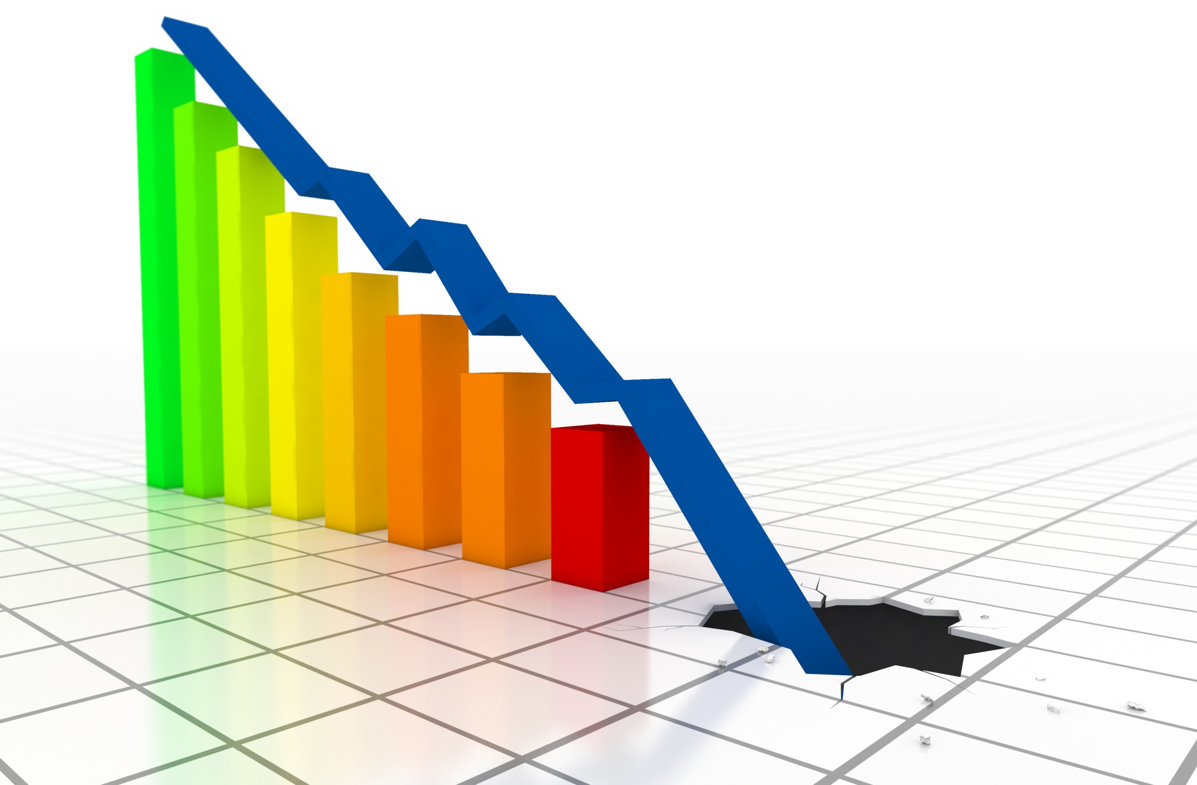
Retrieve VOC level from graph

Slide 9
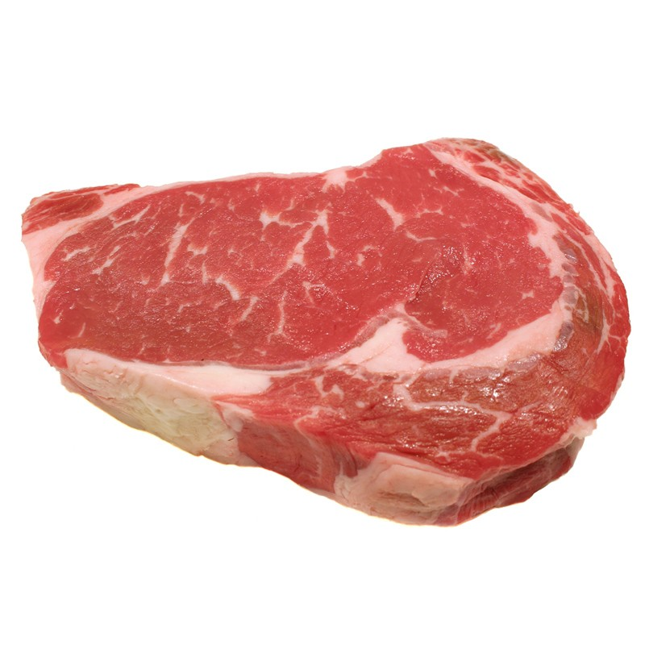
Download raw data from site

Slide 10
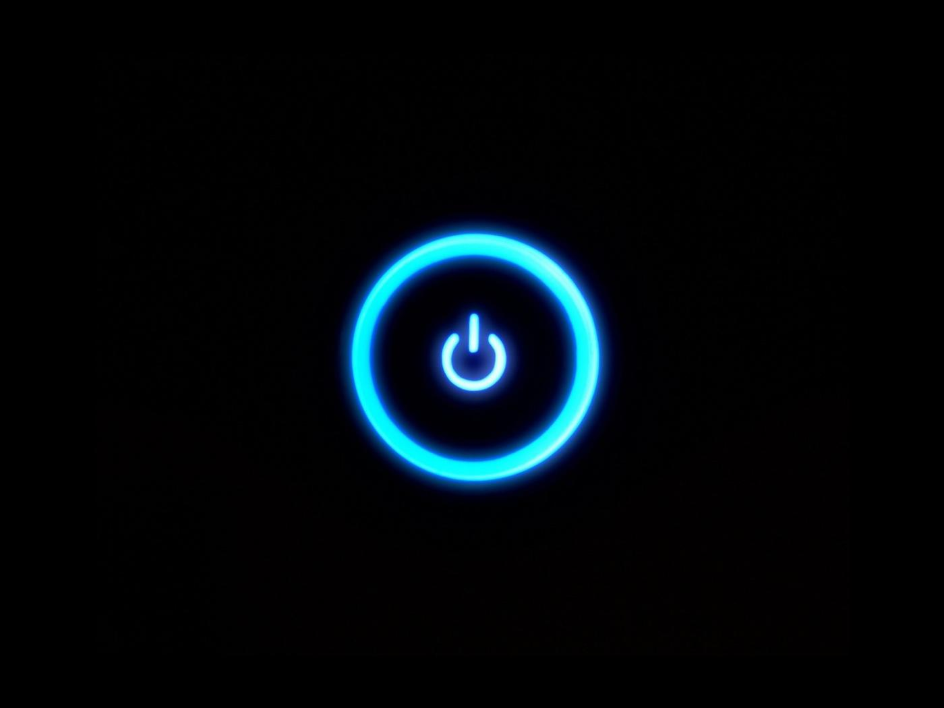
Shut down monitor

Slide 11
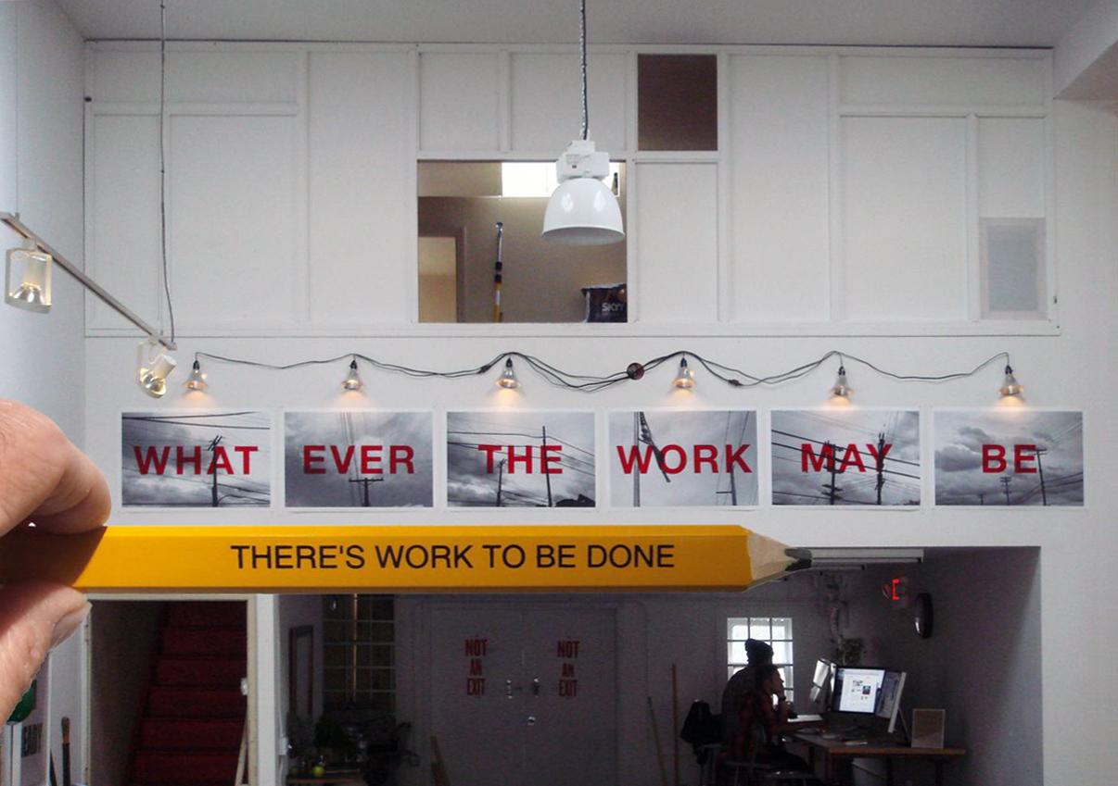
Work still to be done

